Slide 1
Deadline for homework and project reports: 12-9-16
Quiz #4 given 1-3pm Wednesday 12-14-16
Covers material in lectures since quiz3
MLP
RBF-ANN
Clustering
SOM
SVM
Intent of this review is to focus study for quiz #4
Questions will be posted on class web page.
Answers can be found in lecture slides.

Slide 2
Question on ANN

Slide 3
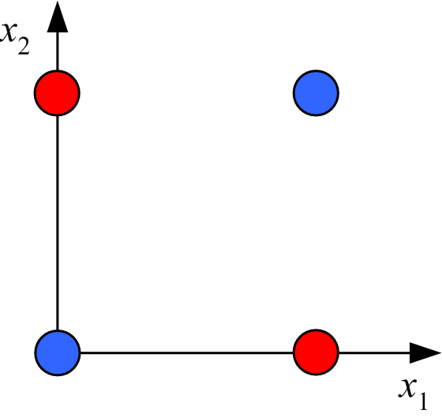
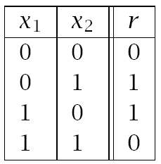
Review: Boolean XOR: linearly inseparable 2D binary classification problem
data table
graphical representation
Both the Gaussian feature space and ANN have the same strategy for solving
this problem. What is that strategy?
Define features such that in feature space they only have three nonlinear features

Slide 4
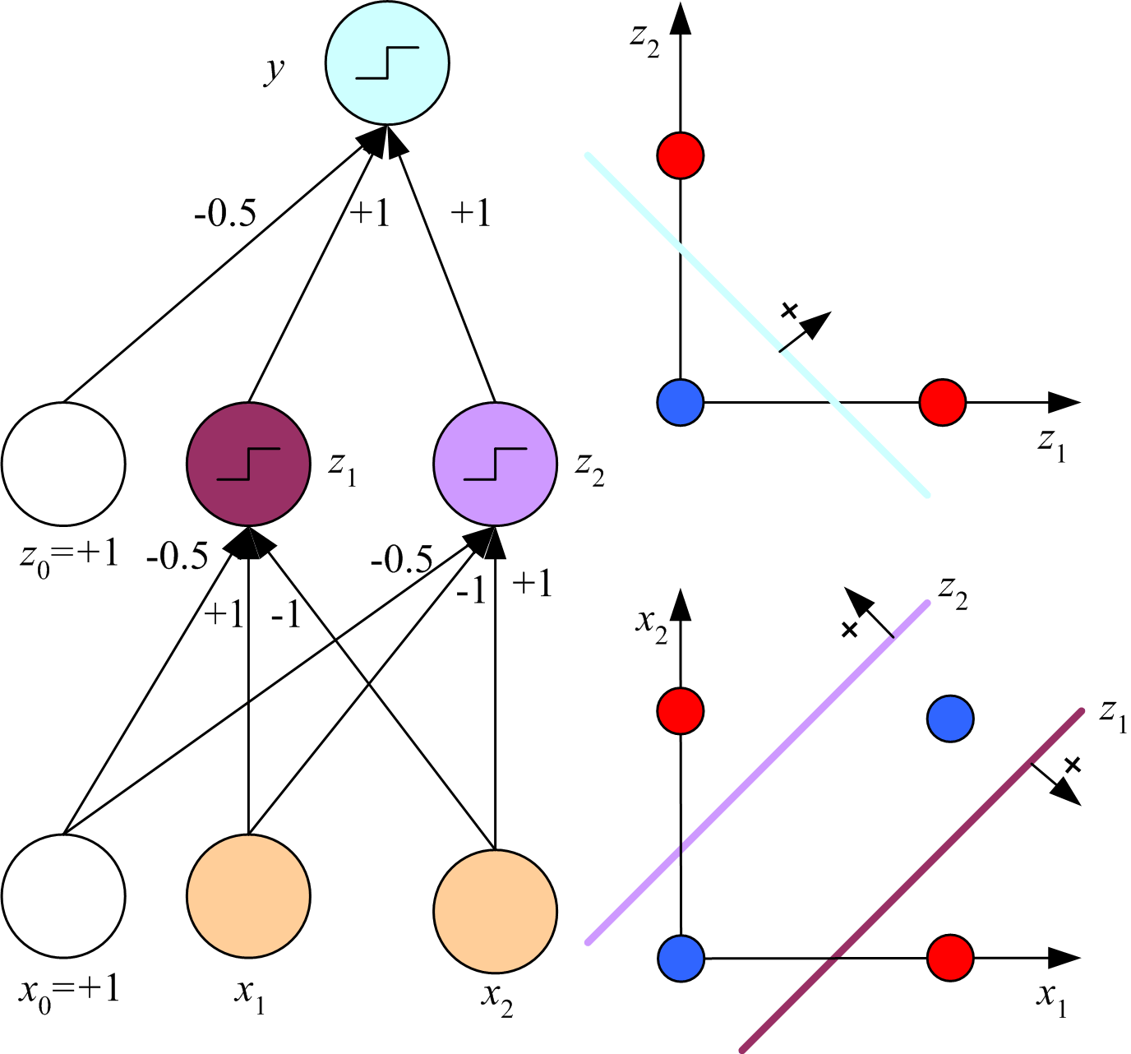
Solution to XOR classification problem by MLP
S
S means that input to a node
has been transformed by the
sigmoid function.
For hidden nodes z₁ and z₂
this means z_{h} = sigmoid(w_{h}^{T}x).
If z_{h} is to be approximately
equal to r for point (0,0) and
(1,1), how do we design w_{h}
to achieve this objective?
Large and negative
-0.78
S
S
4

Slide 5
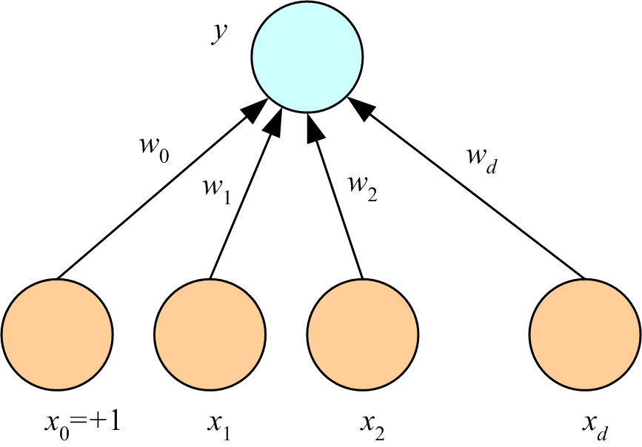



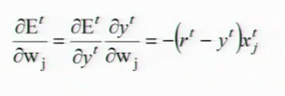
Weights optimized by back propagation
Simplest case: multivariate linear regression
In-sample error is squared residuals and no hidden layers
Derive the weight update formula using
and
answer

Slide 6
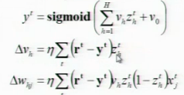
How do “batch” weight-update formulas differ from “on line” formulas?
Batch takes the weight update formula for a single member of the training set
Not cummulitive
After optimum weights have been determined, how so you use an MLP
to make a prediction?
Forward propagation
What is a “training epoch?
One pass through randomized training set

Slide 7
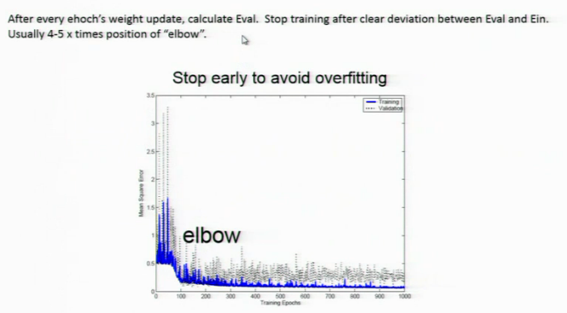
How is a validation set used in the technique “stop early to avoid overfitting”?

Slide 8
Question on Radial basis functions-ANN and Clustering

Slide 9
For regression or classification after binning, weights in a RBF-ANN can be obtained by
“one-step optimization. Explain how this is possible.
The hidden layer of a RBF-ANN are Gaussian features defined from the input by clustering.
The output of RBF-ANN is a linear model in feature space, where Ein is the sum of squared
residuals

Slide 10
K-means clustering is an example of maximum-likelihood parameter estimation by
iterative Expectation-Maximization (EM).
What parameters are being estimated?
Parameters: cluster centers defined as mean of attribute vectors of clusters members
What happens on an E-step?
Defines cluster membership by distance from centers calculated in previous M-step
What happens on a M-step?
New centers using cluster membership from calculated in the previous E-step

Slide 11
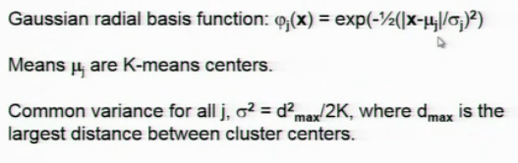
RBF-ANN uses K-means clustering.
How are the parameters of the Gaussian basis functions calculated?

Slide 12
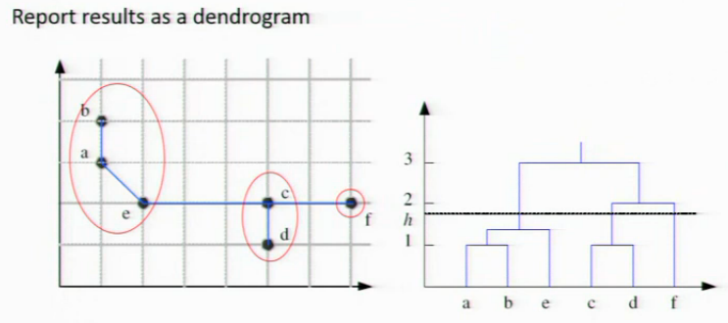
Describe agglomerative clustering with single linkage.
Each iteration merges the 2 closest groups with distance between groups defined as the
Smallest separation between pairs of examples from different groups

Slide 13
Question on Self Organizing Maps

Slide 14
What is the basic objective of self organizing maps?
A lattice of prototypes that approximate a pattern that is contained in training

Slide 15
What are the 3 aspect of training in a SOM algorithm?
Competition among lattice nodes
Cooperatively among neighbor of a winning node
Adaptation of weight vectors

Slide 16
How does a contextual map differ from a semantic map as SOM output?
Contextual map differ from semantic maps in presentation of results only. A semantic
Map marks every output node by input label of the test pattern that induced the strongest
Response. Redundant labels define neighborhoods of strong response. A contextual map
eliminates the redundant labels by just showing the node in the neighborhood with strongest
Redundant.

Slide 17
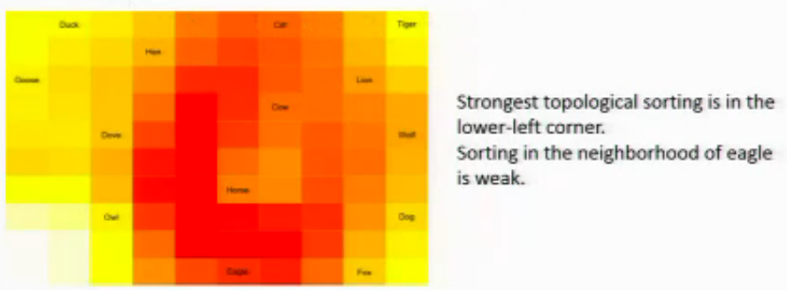
What does the UMAT output add to Sematic map output?
Semantic map shows only topological sorting of prototypes UMAT as adds
strength of sorting. Distance between prototypes is averaged over adjacent
neighbors (2, 3, and 4 adjacent neighbors for corner, edge and internal nodes,
respectively). Average distance can be displayed in a heat map with shorted
distance indicated by lighter color.

Slide 18
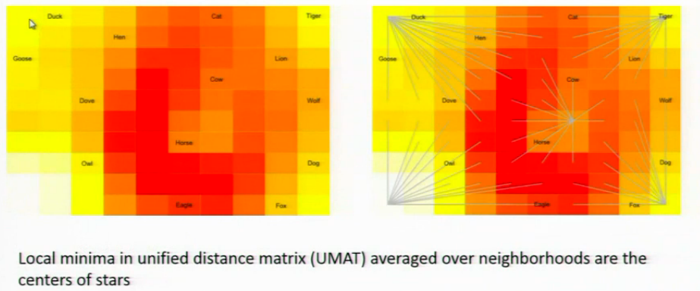
How does a UMAT enable definition of “stars”?

Slide 19
What do “stars” add to a UMAT output?
Each star defines a cluster in the output lattice. Rays from a stars define the boundaries of
these cluster

Slide 20
As a clustering method, what is the main advantage of SOM?
The number of clusters does not have to specified to execute the method

Slide 21
Questions on support vector machines

Slide 22
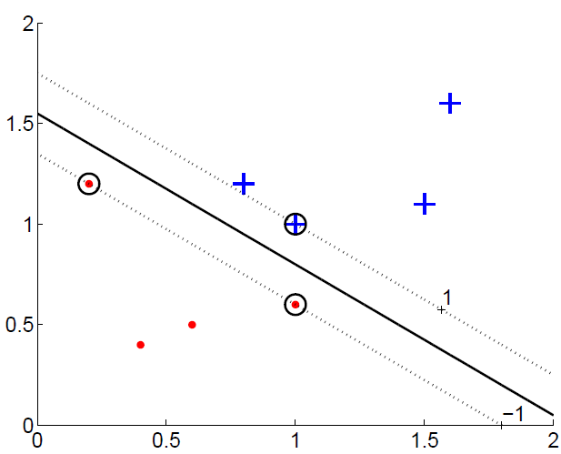
Why is maximizing margins a good strategy for classification?
Separating hyperplane
It improves generalization
Support vectors
margins
Lecture Notes for E Alpaydın 2010 Introduction to Machine Learning 2e © The MIT Press (V1.0)
22

Slide 23
In L_{p}, which variables are primal and which are dual?
How does L_{p} get changed into L_{d}; shown below with only dual variables?
In L_{p}, w and w₀ are primal, a’s are dual
Setting the derivatives of L_{p} with respect to primal variables equal to zero gives relationships
between primal and dual variables that allow the former to be removed from the Lagrangian

Slide 24
What is the “active set” in constrained optimization?
How does maximization of the dual make constraints on
support vectors the active set?
Active set is the subset of constraints actually used in the optimization.
In the maximization of Ld, all a’s for examples that are not support vectors are
set to zero; hence, constraints on support vectors become the active set.

Slide 25
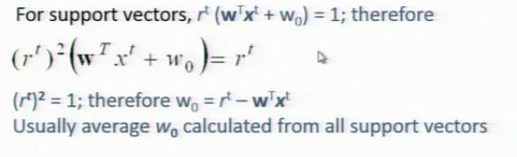
Maximize
Set α^{t} = 0 for data point sufficiently far from discriminant to be ignored in the search for hyperplane with maximum margins.
Find remaining a^{t} > 0 by quadratic programing
Given the a^{t} > 0 that maximize L_{d} calculate
What is the dimension of w?
How do you find a value for w₀?
W has the same dimension as xt, the number of attributes in an example
Lecture Notes for E Alpaydın 2010 Introduction to Machine Learning 2e © The MIT Press (V1.0)
25

Slide 26
In constrained optimization, constraints are placed on primal variables,
for example:
maximize
L_{d} does not contain any primal variables.
What are the origins of the constraints placed on its maximization?
Dual variables are Lagrange multplier, which are always non negative
Other constraints on dual variables come derivatives of Lp set to zero

Slide 27
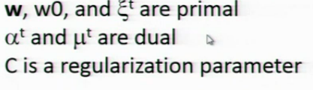
In the equation for Lp below, which variables are primal and which are dual?
Does L_{p} contain any parameters? If so, what is their purpose?
Answer:

Slide 28
The components of soft error =
have the form of “hinge loss”
xt with rt = 1 is correctly classified but in the margins. What are the bounds on hinge loss?
xt with rt = 1 is misclassified. (a) What are the bounds on hinge loss if xt is in the margins? (b) What are the bounds on hinge loss if xt is outside of the margins?
Correctly classified but in the margins 0<hinge loss<1
Incorrectly classified but in the margins 1<hinge loss<2
Incorrectly classified not in the margins hinge loss>2

Slide 29
How does the value of regularization parameter C effects binary
classification by SVM with slack variables?
Small values of C allow wider margins but more points in the margins and
misclassified (i.e. the penalty for points in the margin and misclassified points is less)

Slide 30

The L_{p} for ν-SVM, with constraints included, is shown below.
What are the primal variables? What are the dual variables
Does it contain any parameters? If so, what is their purpose?

